Slide 1
Cascading Style Sheet

Slide 2
Types of Stylesheets
There are three standard ways to add CSS styles to an HTML document.
Inline CSS - CSS is written directly inside the HTML element using the style attribute
Example:
<p style="color:blue; font-size: 20px;">
Welcome to Web Technology
</p>
Easy for applying a style to a single element.
Useful for quick testing.
Internal CSS (Embedded CSS) - The CSS is written inside a <style> tag within the <head> section of the HTML document.
<html>
<head>
<style>
h1 { color: navy; text-align: center; }
p { color: gray; }
</style>
</head>
<body>
<h1>TechNova 2026</h1>
<p>National Level Technical Symposium</p>
</body>
</html>
→ Styles all elements within a single webpage

Slide 3
Types of Stylesheets
External CSS - The CSS is stored in a separate .css file and linked to the HTML document using the <link> tag
HTML (index.html)
<!DOCTYPE html>
<html>
<head>
<link rel="stylesheet" href="style.css">
</head>
<body>
<h1>TechNova 2026</h1>
</body>
</html>
CSS (style.css)
h1 {
color: green;
text-align: center;
}
→ Best for multi-page websites
Reusable across multiple HTML
pages
→ Separates content (HTML) from presentation (CSS)

Slide 4
Types of Stylesheets
Method | Where CSS is Written | Scope | Reusability | Best Use
Inline CSS | Inside the style attribute of an HTML element | Single element | No | Quick testing or one-off styling
Internal CSS | Inside a <style> tag in the <head> | Single HTML page | No | Small, single-page websites
External CSS | In a separate .css file linked with <link> | Multiple HTML pages | Yes | Medium and large websites (recommended

Slide 5
CSS Selectors
CSS selectors are used to "find" (or select) the HTML elements you want to style.
We can divide CSS selectors into five categories:
Simple selectors (select elements based on name, id, class)
Combinator selectors (select elements based on a specific relationship between them)
Pseudo-class selectors (select elements based on a certain state)
Pseudo-elements selectors (select and style a part of an element)
Attribute selectors (select elements based on an attribute or attribute value)

Slide 6
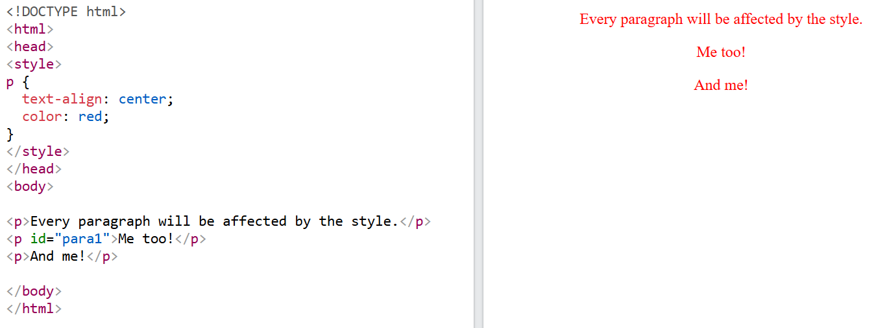
CSS Selectors - Examples
Element Selector

Slide 7
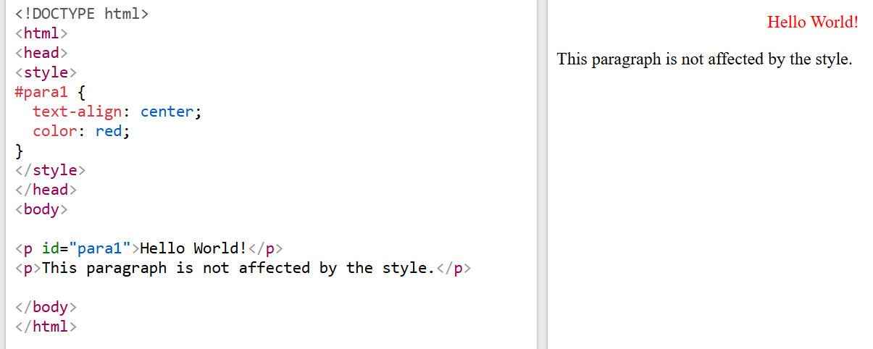
CSS Selectors - Examples
ID Selector
Uses the id attribute of an HTML element to select a specific element.
The id of an element is unique within a page, so the id selector is used to select one unique element!
To select an element with a specific id, write a hash (#) character, followed by the id of the element.

Slide 8
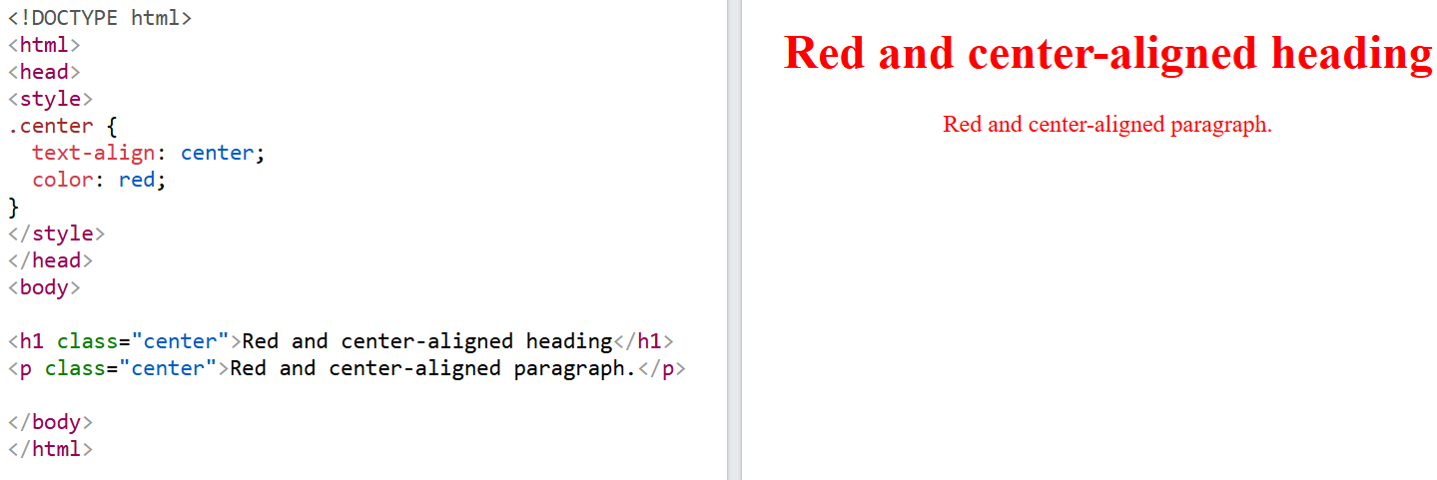
CSS Selectors - Examples
Class Selector
Selects HTML elements with a specific class attribute.
To select elements with a specific class, write a period (.) character, followed by the class name.

Slide 9
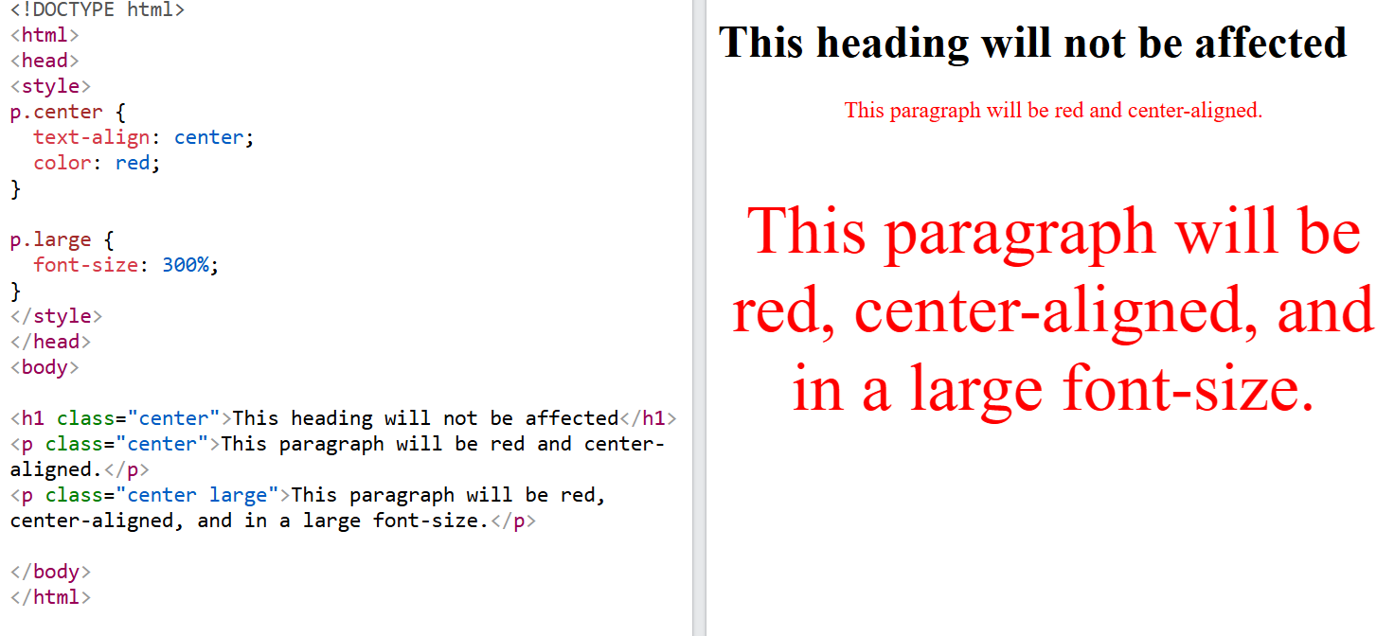
CSS Selectors - Examples
HTML elements can also refer to more than one class.
Example
In this example the <p> element will be styled according to class="center" and to class="large":

Slide 10
CSS Selectors - Examples
HTML elements can also refer to more than one class.
Example
In this example the <p> element will be styled according to class="center" and to class="large":

Slide 11
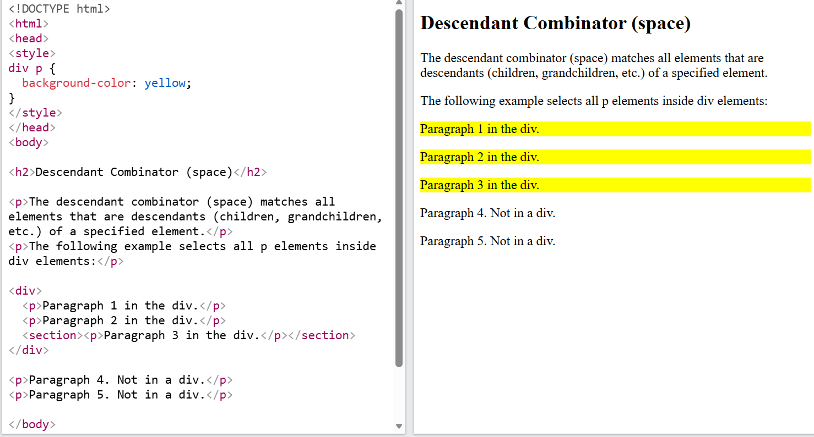
CSS Combinators - Examples
A combinator is something that defines the relationship between two or more selectors.
There are four different combinators in CSS:
Descendant combinator (space)
Child combinator (>)
Next sibling combinator (+)
Subsequent-sibling combinator (~)

Slide 12
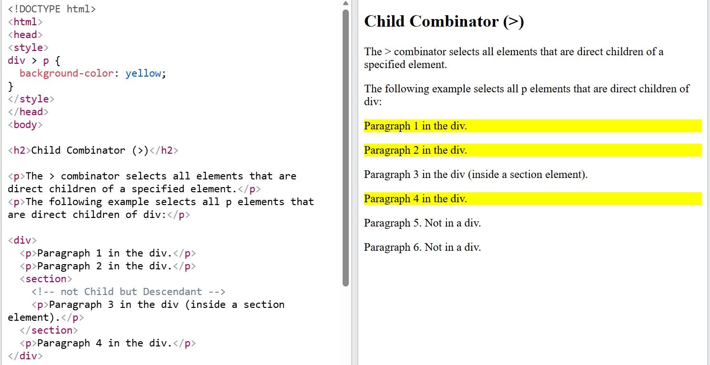
CSS Combinators - Examples
Child Combinator (>)
→ Selects all elements that are direct children of a specified element.
The following example selects all <p> elements that are direct children of <div>:

Slide 13
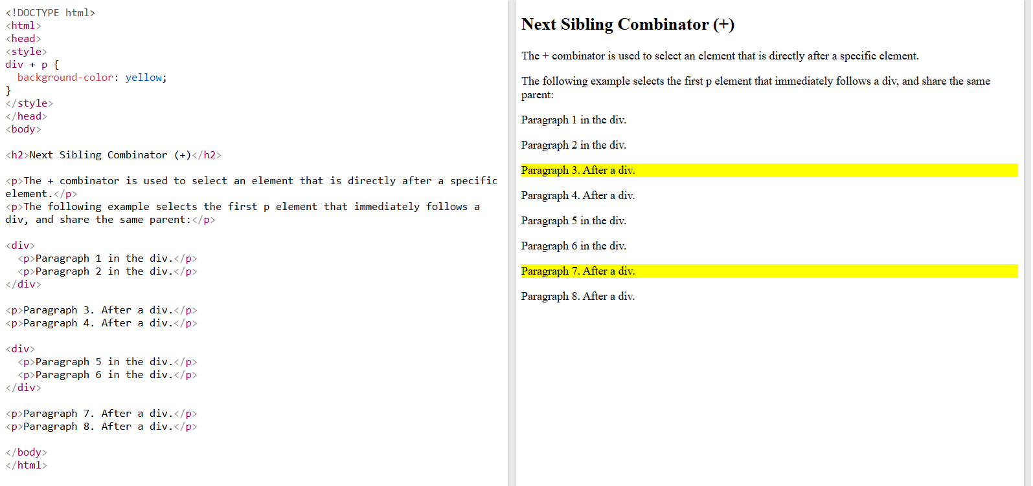
CSS Combinators - Examples
Next Sibling Combinator (+)
→ used to select an element that is directly after a specific element.
→ Sibling elements must have the same parent element.
The following example selects the first <p> element that immediately follows a <div>, and share the same parent:

Slide 14
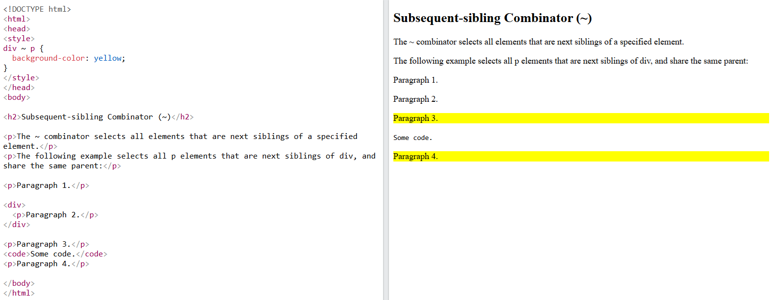
CSS Combinators - Examples
Subsequent-sibling Combinator (~)
→ Selects all elements that are next siblings of a specified element.
The following example selects all <p> elements that are next siblings of <div>, and share the same parent:

Slide 15
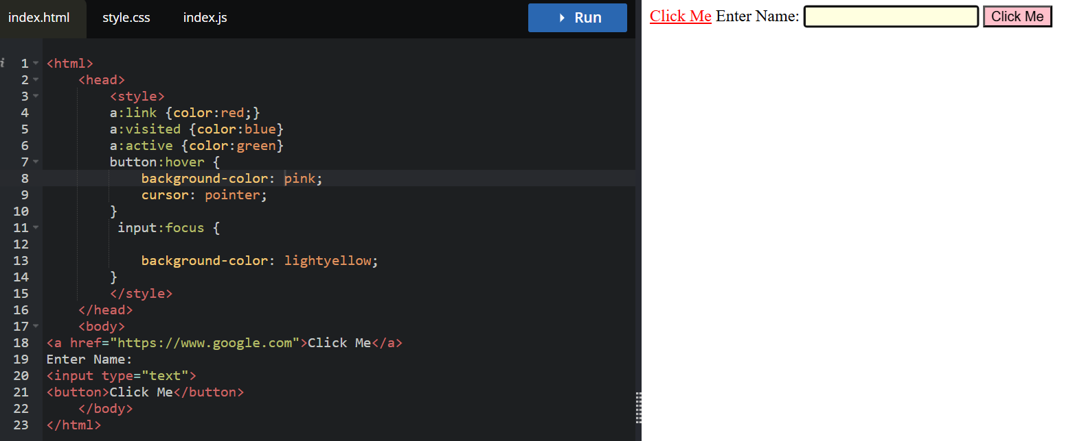
CSS Interactive Pseudo-classes - Examples
Interactive pseudo-classes apply styles based on user interaction:
:hover - When mouse is over an element
:focus - When an element has focus
:active - When an element is being activated
:link - Unvisited links
:visited - Visited links

Slide 16
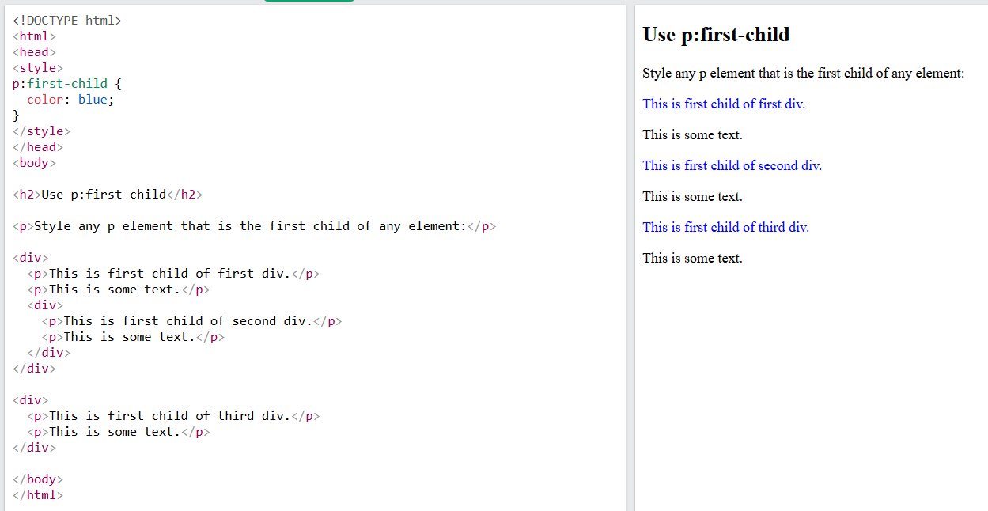
Structural Pseudo-class Elements
Structural pseudo-classes because they select elements based on the structure of the HTML document (DOM tree), specifically the relationship between a parent and its children.
The :first-child pseudo-class matches a specific element that is the first child of another element.

Slide 17
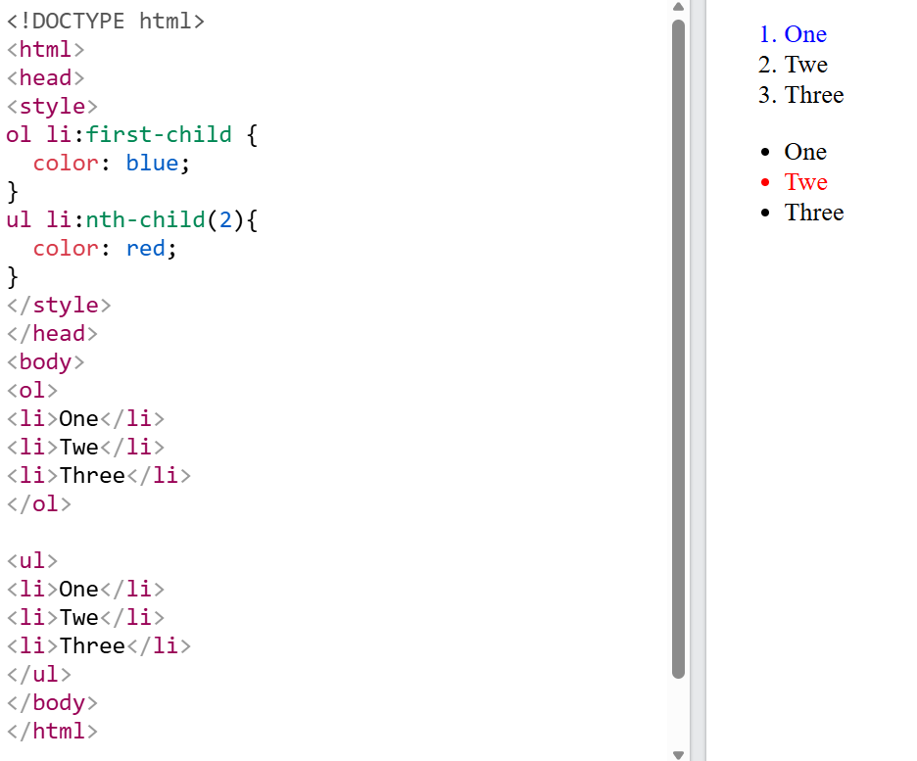
Structural Pseudo-class Elements
:last-child
Selects the last child of its parent.
:nth-child(n)
Selects the nth child of the parent

Slide 18
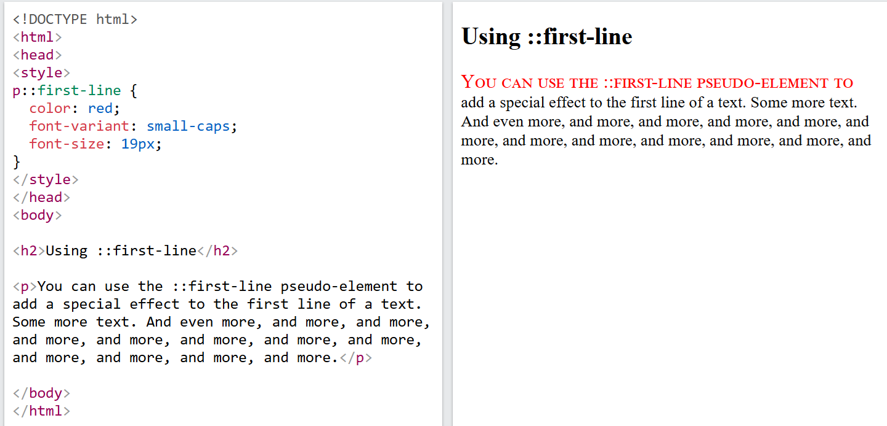
Structural Pseudo Elements
Pseudo-elements for text, allow you to style specific parts of text content, such as the first line or first letter.
::first-line pseudo-element is used to add a special style to the first line of a text.

Slide 19
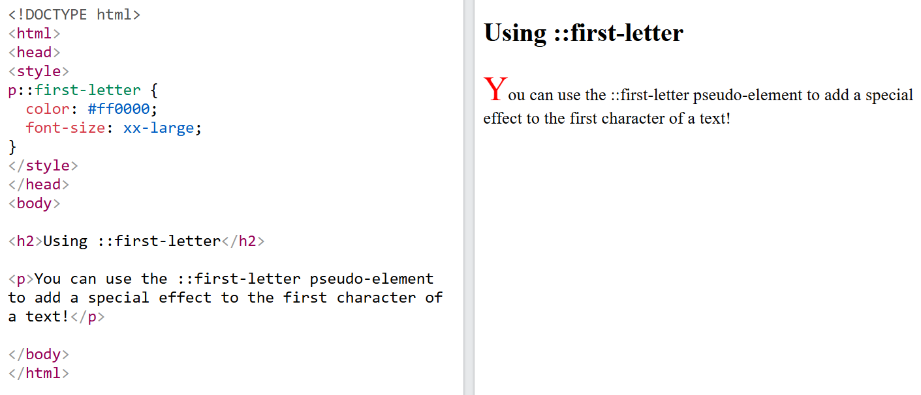
Structural Pseudo Elements

Slide 20
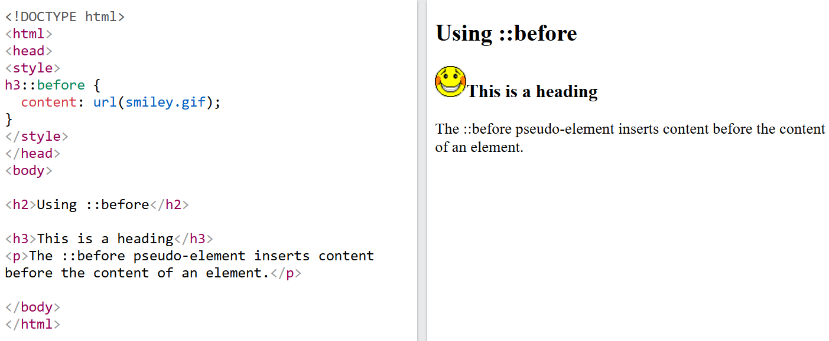
Structural Pseudo Elements - Content
Pseudo-elements for content allow you to insert content before or after elements, style list markers, and more.

Slide 21
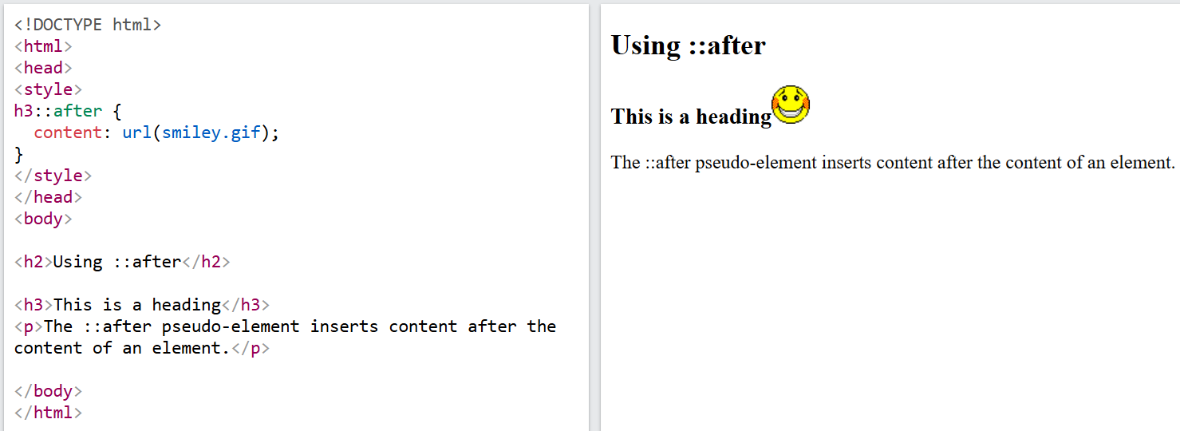
Structural Pseudo Elements - Content
Pseudo-elements for content allow you to insert content before or after elements, style list markers, and more.

Slide 22
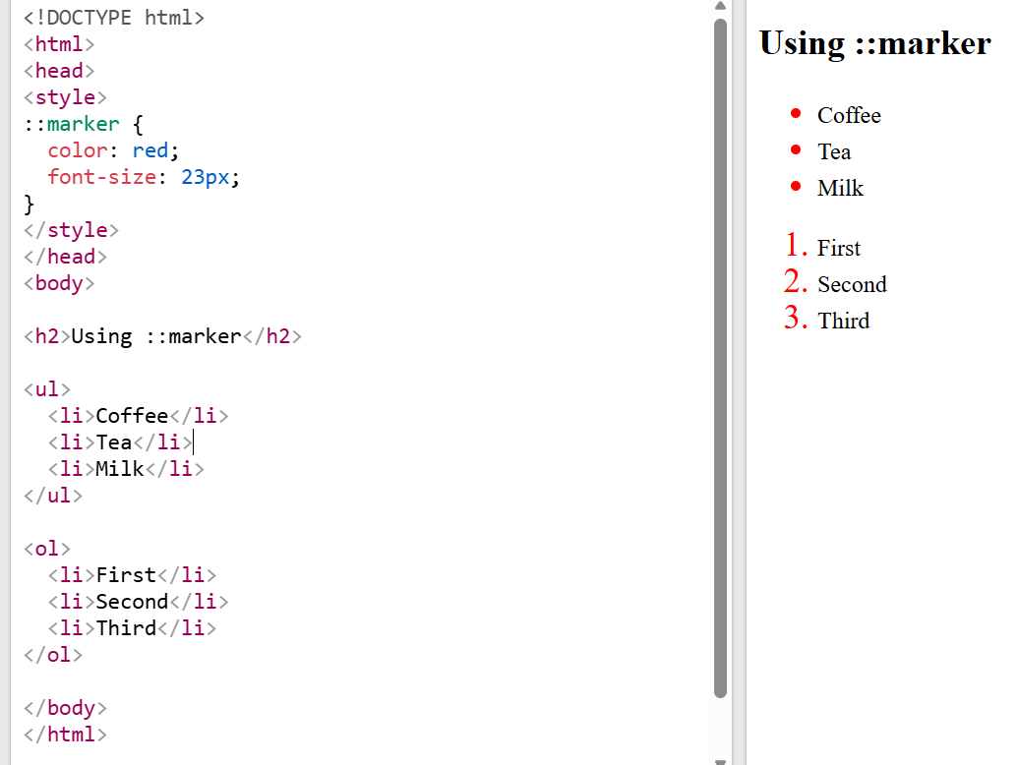
Structural Pseudo Elements - Content
The ::marker pseudo-element is used to style the list item markers.

Slide 23
CSS Attribute Selector
CSS attribute selectors are used to select and style HTML elements with a specific attribute or attribute value, or both.
Attribute selectors are enclosed in square brackets [].
CSS has the following attribute selectors:
[attribute] - Select elements with the specified attribute
[attribute="value"] - Select elements with a specific attribute and an exact value
[attribute~="value"] - Select elements with an attribute value containing a specific word
[attribute^="value"] - Select elements whose attribute value starts with a specific value
[attribute$="value"] - Select elements whose attribute value ends with a specific value
[attribute*="value"] - Select elements whose attribute value contains a specific value

Slide 24
CSS Attribute Selector - Example
<style>
/* 1. Attribute Exists */
input[required] {
border: 2px solid blue;
}
/* 2. Exact Value */
input[type="password"] {
background-color: lightyellow;
}
/* 3. Starts With */
a[href^="https"] {
color: green;
}
/* 4. Ends With */
img[src$=".png"] {
border: 3px solid red;
}
<input type="text" required placeholder="Name">
<input type=“password" placeholder="City">
<a href="https://google.com">Google</a><br>
<a href="http://example.com">Example</a><br>
<a href="https://github.com">GitHub</a>
<img src="flower.png" width="100" height="100" alt="Flower PNG">
<img src="dog.jpg" width="100" height="100" alt="Dog JPG">

Slide 25
CSS Attribute Selector - Example
<style>
/* 5. Contains */
div[class*="card"] {
background-color: lightblue;
padding: 10px;
margin: 5px;
}
/* 6. Contains Whole Word */
p[class~="important"] {
color: red;
font-weight: bold;
}
/* 7. Hyphen-Separated Value */
p[lang|="en"] {
background-color: lightgray;
}
<h2>5. Contains *=</h2>
<div class="card">Card</div>
<div class="card-large">Large Card</div>
<div class="box">Box</div>
<h2>6. Whole Word ~=</h2>
<p class="note important">
Paragraph 1 (Selected)
</p>
<p class="important">
Paragraph 2 (Selected)
</p>
<p class="important-note">
Paragraph 3 (Not Selected)
</p>
<h2>7. Hyphen-Separated |=</h2>
<p lang="en">Hello</p>
<p lang="en-US">Welcome</p>
<p lang="fr">Bonjour</p>

Slide 26
CSS Selectors
CSS selectors are patterns used to target HTML elements so you can apply styles or manipulate them with JavaScript.
Selector | Syntax | Purpose
Universal | * | All elements
Element | p | All <p> elements
Class | .box | Elements with a class
ID | #header | Unique element
Group | h1, h2 | Multiple selectors
Descendant | div p | Nested descendants
Child | div > p | Direct children
Attribute | input[type="text"] | Elements with matching attributes
Pseudo-class | button:hover | Element state or position
Pseudo-element | p::first-letter | Part of an element

Slide 27
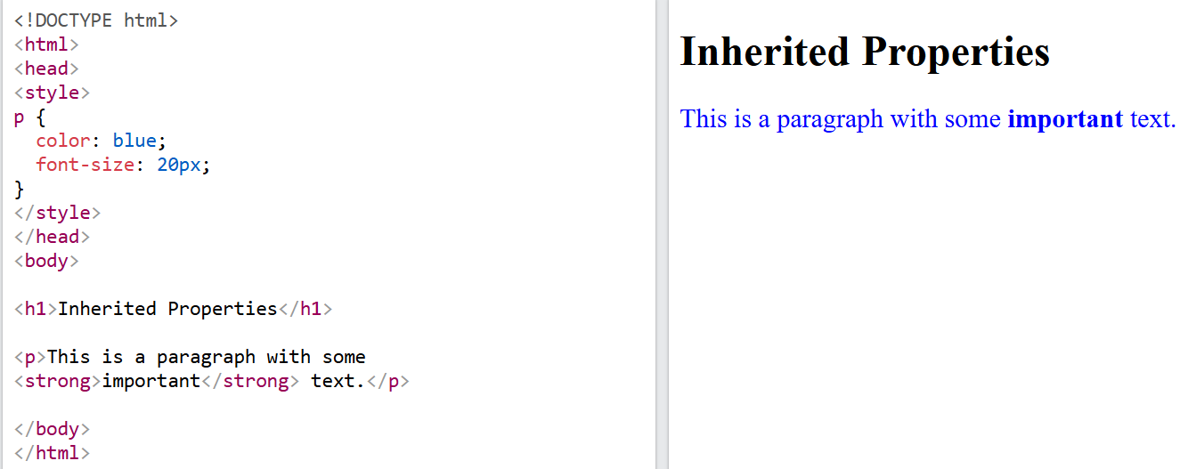
CSS Inheritance
CSS inheritance is about what happens if no value is specified for a property on an element.
If no value is specified for a property, the value can either be inherited from the parent element, or be set to its initial (default) value.
For CSS inheritance, properties are categorized in two types:
inherited properties
non-inherited properties
Properties related to text, such as color, font-family, font-size, line-height, and text-align, are typically inherited. This ensures consistent text styling throughout a document.

Slide 28
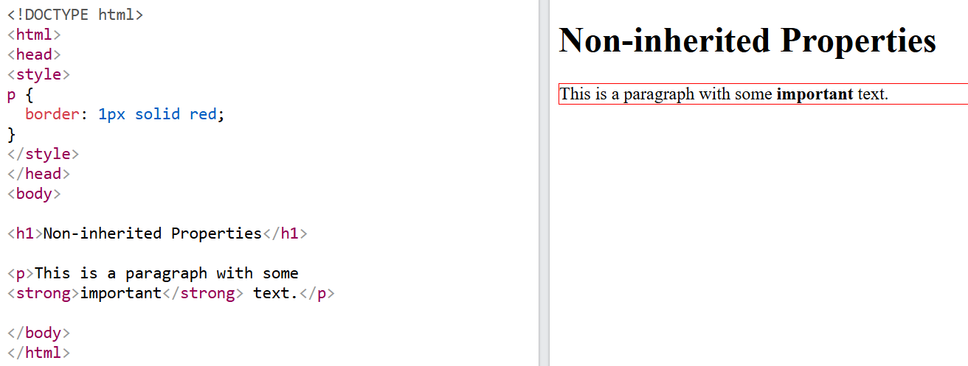
CSS Inheritance
Non-inherited properties
Properties related to the box model or layout, like border, background, margin, padding, width, and height, are typically not inherited.

Slide 29
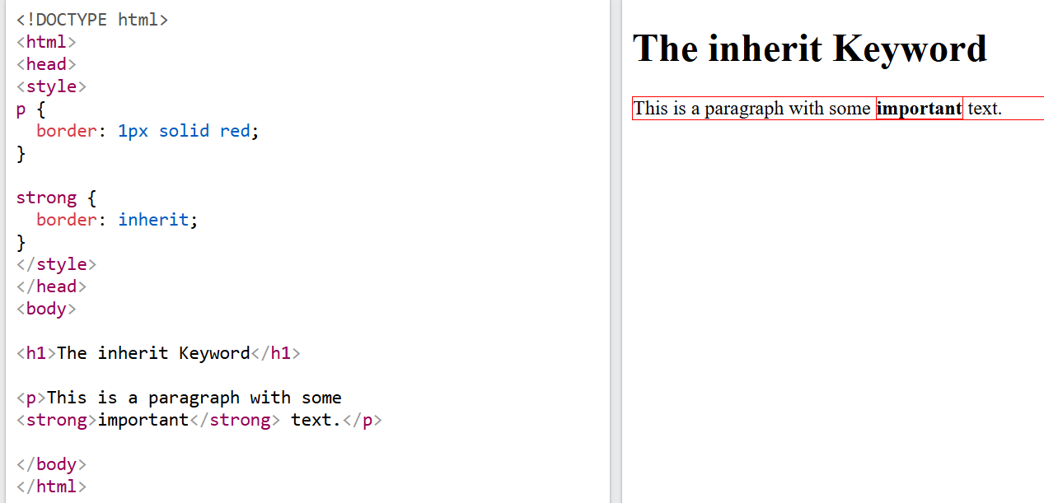
CSS Inheritance
The inherit keyword is used to explicitly specify inheritance. It works on both inherited and non-inherited properties.
In the following example, the <strong> element, inside the <p> element, will have an additional border, since we have used the inherit keyword to explicitly specify that the border value should be inherit.

